Slide 1

Developing a Business Model Using the Business Model Canvas (BMC)
By Dr Kalpana Ambepitiya
President of KDU Entrepreneurship Lab
Head of UNESCO Entrepreneurship Education Network Sri Lanka National Chapter
Director, Career Guidance Unit
General Sir John Kotelawala Defence University

Slide 2

Workshop Objectives
1
Understand what a business model is and why it is important.
2
Learn the 9 building blocks of the Business Model Canvas (BMC).
3
Analyze real-world case studies of successful business models.
4
Develop and present a business model for a startup idea.

Slide 3
Innovation
Innovation is improving, modifying, or applying an invention to solve real-world problems, create value, and achieve market success. It adds practical and commercial viability to an invention.
Can be an improvement of an existing product or process
Focuses on usability and market fit
Can be technological, business model, or process innovation
Often requires customer feedback and iterative development
Examples - Smartphones (An innovation based on the telephone), Electric cars (An innovation based on conventional vehicles), E-commerce platforms (An innovation using the internet for trade)

Slide 4
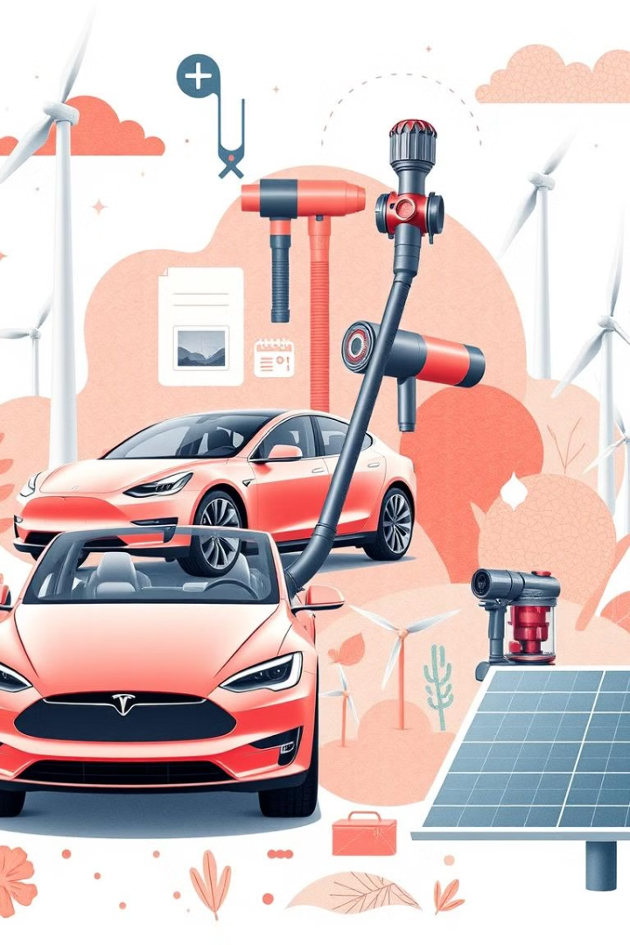
What is a Business Model?
A business model describes how a company creates, delivers, and captures value.
Why it matters? - Helps businesses stay competitive, attract investors, and ensure sustainability.
Example: McDonald’s – Fast-food franchising model

Slide 5
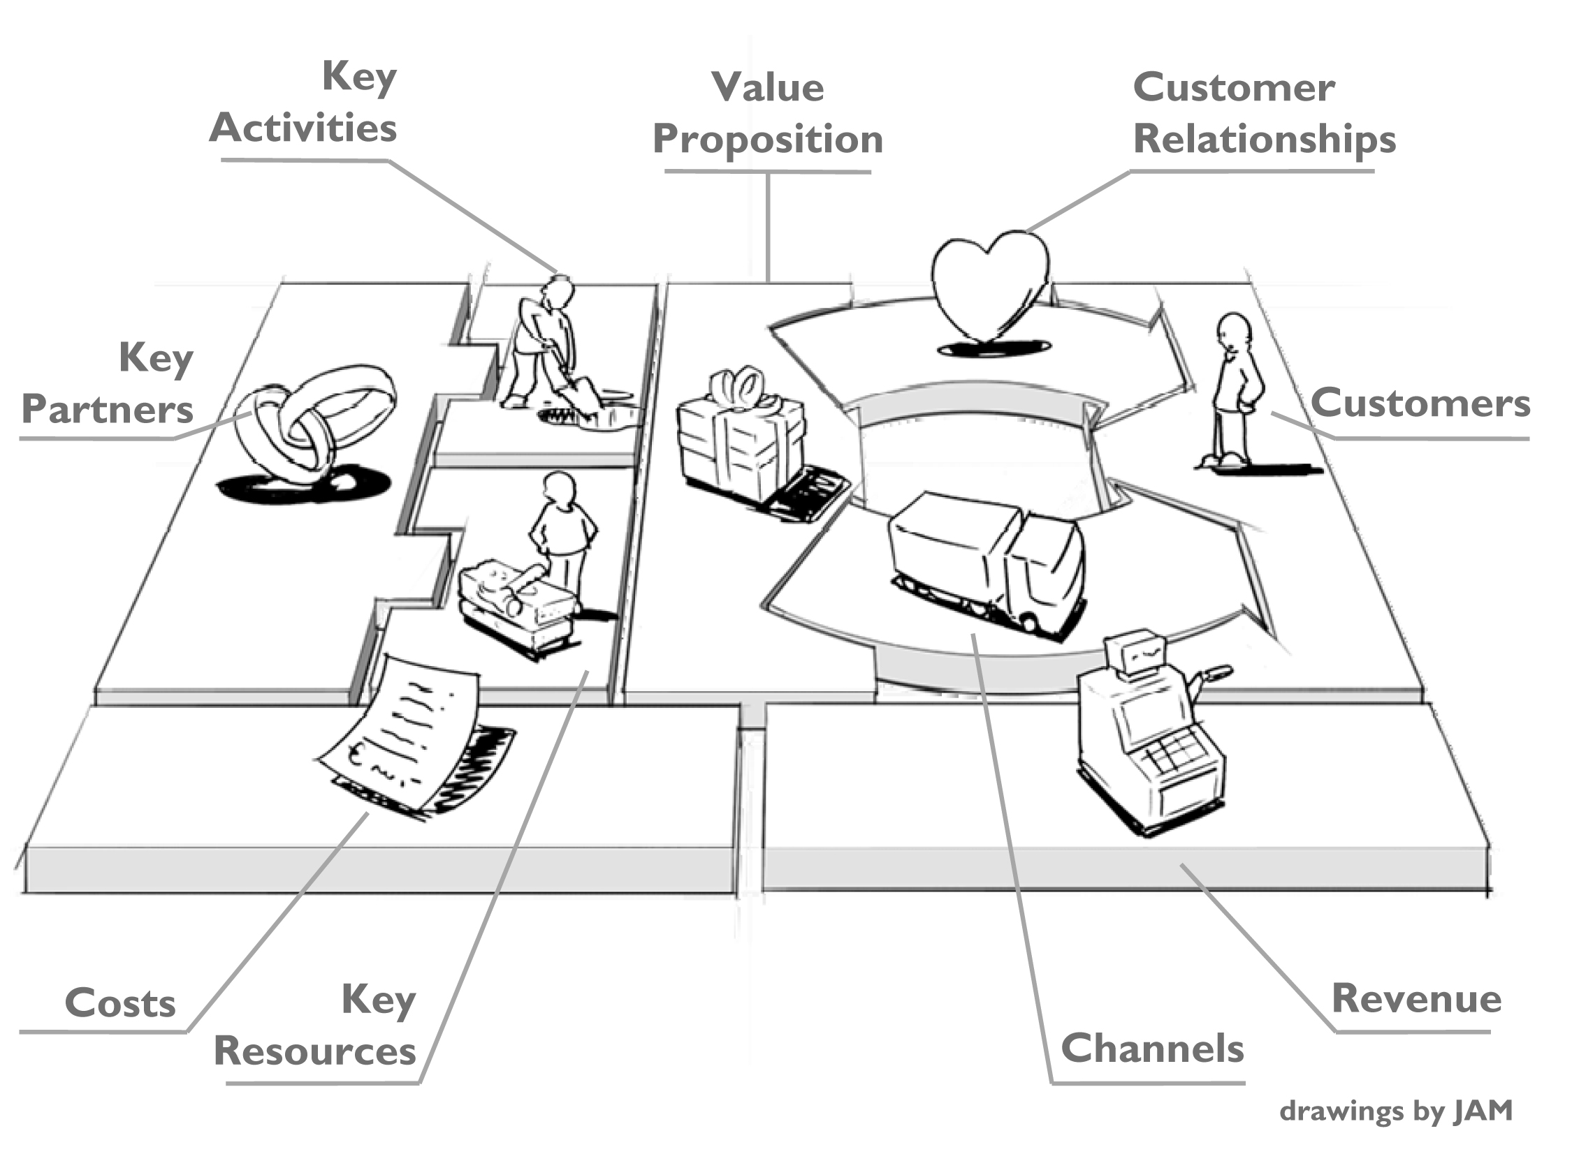
Introduction to the Business
Model Canvas (BMC)

Slide 6
The 9 Building Blocks of BMC
Customer Segments
Different groups of people or organizations that your business serves.
Netflix serves binge-watchers, families, and international audiences.
Who are your target customers? What are their needs?
Value Proposition
The unique value your business offers to solve a customer problem.
Uber provides affordable, convenient, and on-demand rides.
What pain points does your business solve? Why will customers choose you?
Channels
How your company delivers products or services to customers.
Example: Amazon uses e-commerce, third-party sellers, and logistics networks.
How do you reach your customers? What platforms or sales channels do you use?

Slide 7
The 9 Building Blocks of BMC
Customer Relationships
How a business interacts with and retains customers.
Starbucks’ Loyalty Program builds long-term customer engagement.
How do you interact with your customers? How do you build trust and loyalty?
Revenue Streams
The ways a company makes money from its customers.
Spotify earns revenue through subscriptions and advertisements.
What are customers willing to pay for? How do you generate income?
Key Resources
The essential assets that enable a business to operate.
Tesla’s battery technology and manufacturing plants are critical assets.
What resources are essential to delivering your value proposition?

Slide 8
The 9 Building Blocks of BMC
Key Activities
The core processes and operations that drive the business.
Apple focuses on product design, R&D, and marketing.
What activities must your business perform to succeed?
Key Partnerships
Strategic alliances that help businesses grow and operate efficiently.
Nike’s partnership with Michael Jordan for branding and sales.
Who are your key partners? How do they contribute to your success?
Cost Structure
The major expenses required to run the business.
Manufacturing, R&D, and marketing are major costs for Tesla.
What are your main cost drivers? How can you optimize costs?

Slide 9
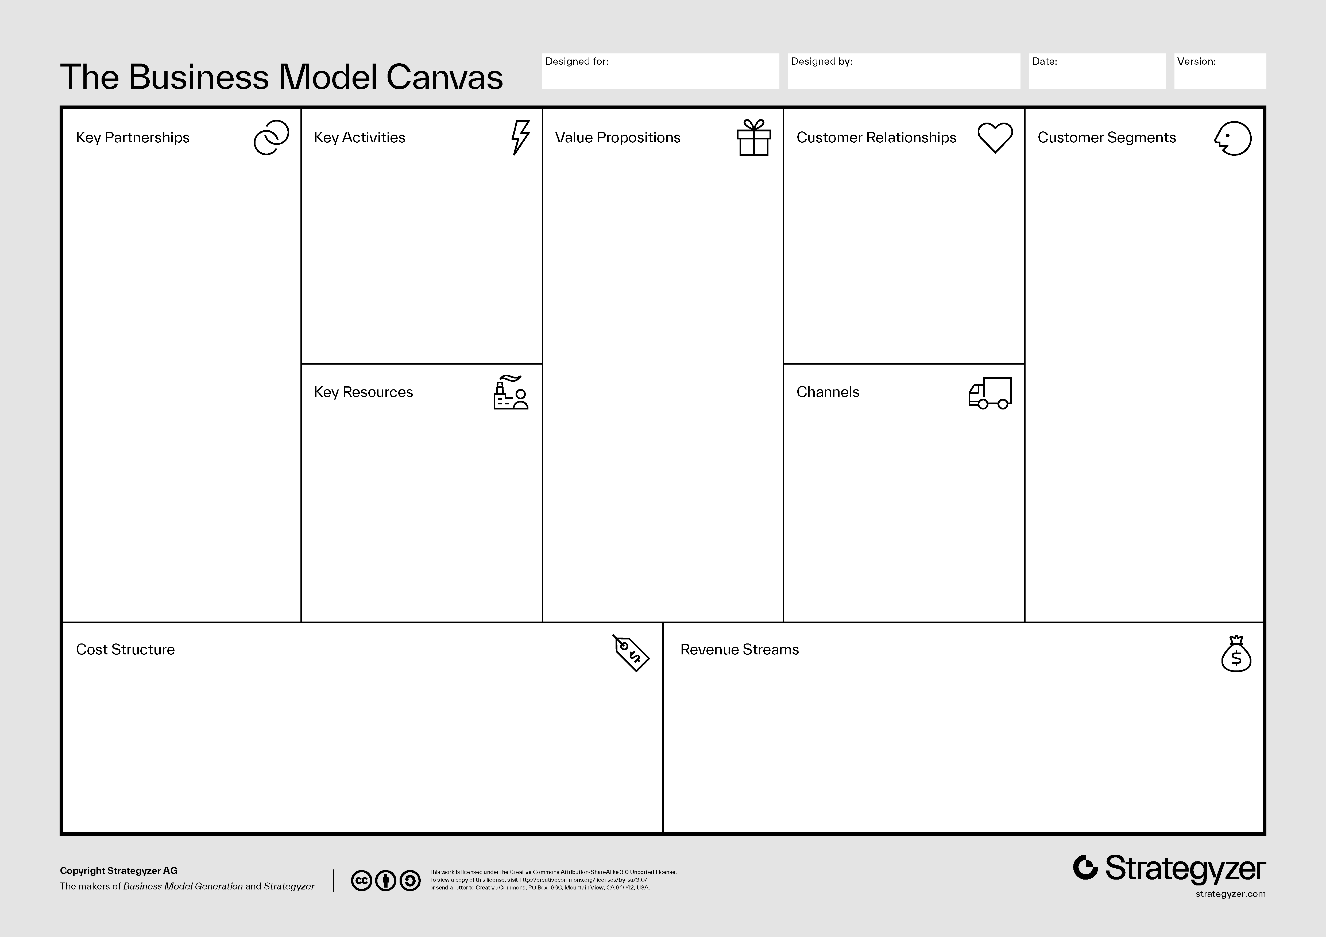

Slide 10


Case Study Netflix vs. Blockbuster
Netflix's Business Model Innovation
Problem
Late fees and inconvenience of DVD rentals.
Innovation
Subscription-based, on-demand streaming.
Outcome
Disrupted the entire video rental industry.
Why did Netflix’s business model succeed while Blockbuster failed?

Slide 11
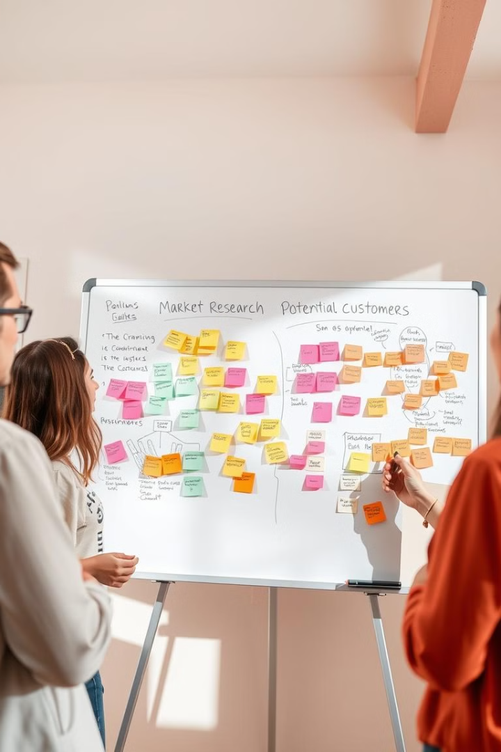
Developing Your Own
Business Model (Activity)
Task
Think of a business idea or startup concept.
Use the BMC to develop your business model.
Prepare a 1-minute pitch.
Time: 30 minutes for brainstorming & canvas completion.

Slide 12
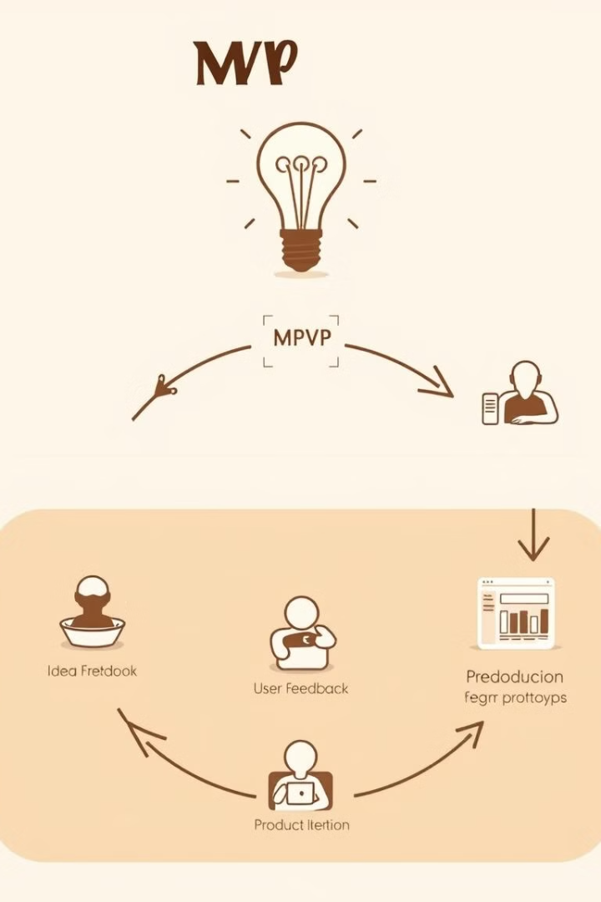
Common Mistakes in
Business Models
Ignoring customer needs (Solution without a problem).
Not validating the Revenue Model (How will you make money?).
Overcomplicating the Value Proposition (Be clear and simple).
Ignoring competition and market trends.
Solution: Test, adapt, and refine continuously!

Slide 13

Key Takeaways
The BMC is a powerful tool for defining a business model.
Every business needs a clear Value Proposition & Revenue Model.
Case studies help understand why some models succeed and others fail.
Test, refine, and adapt your business model continuously.
Next Steps - Try developing a BMC for your own business idea!

Slide 14
Thank you
Linkedin: Kalpana Ambepitiya PhD
Tiktok: BESTBIT with Dr Kalpana
Youtube: BESTBIT
Facebook: Kalpana Ambepitiya
Phone: 0777612155
Email: kalpana.ambepitiya@kdu.ac.lk

